Slide 1
Week - 2
Presented by:
Shafin Bin Hamid
Lecturer
Department of Electrical and Electronics Engineering
Bangladesh University of Engineering and Technology

Slide 2
Outline
Kirchoff’s laws
Voltage and current divider rule
Wye-delta transformation
Nodal analysis
Mesh analysis

Slide 3
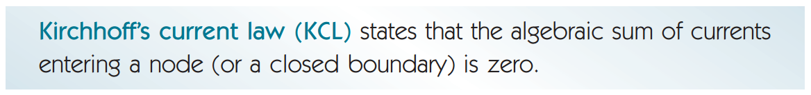
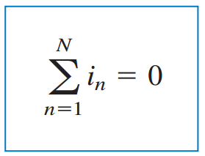
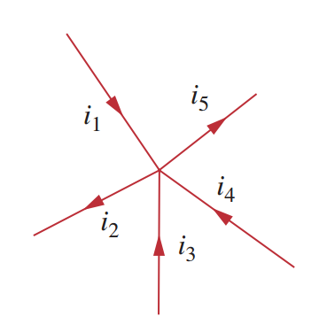
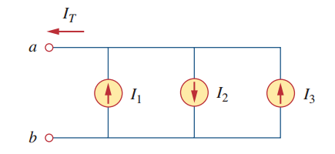
Kirchoff’s Current Law

Slide 4
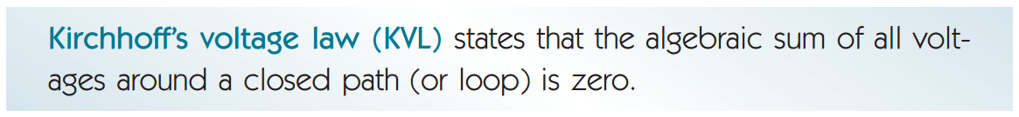
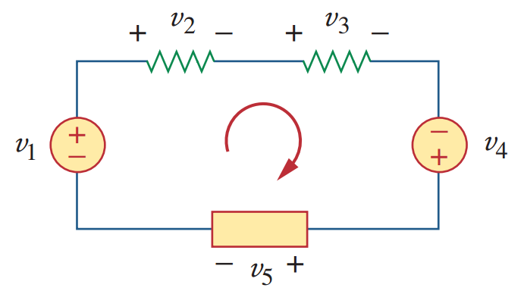
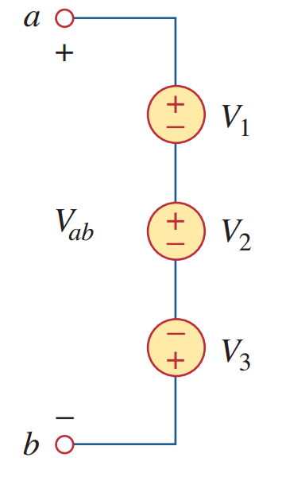
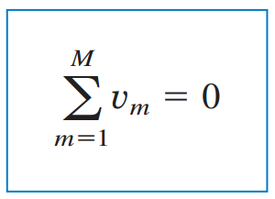
Kirchoff’s Voltage Law

Slide 5
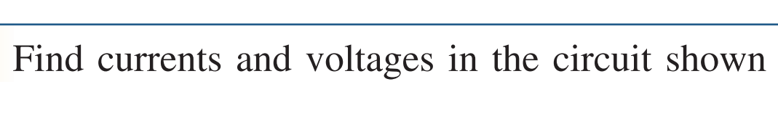
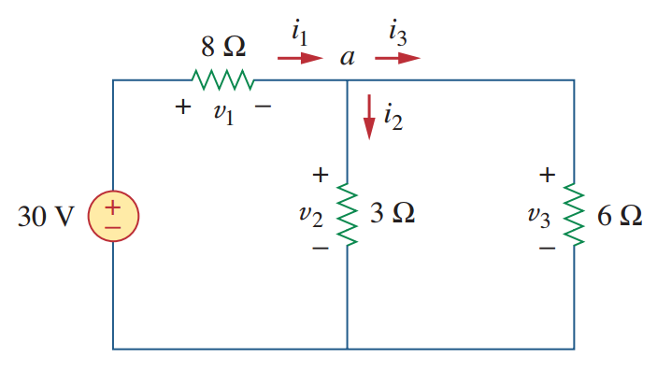
Problems

Slide 6
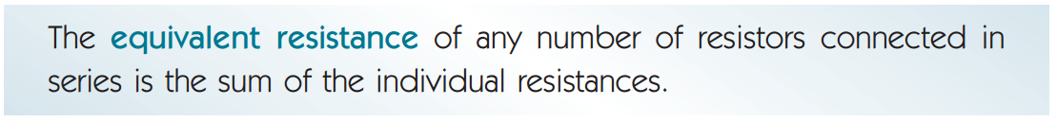
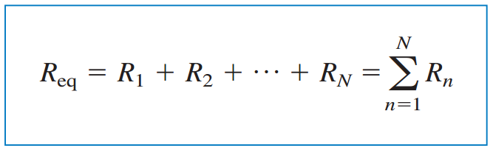
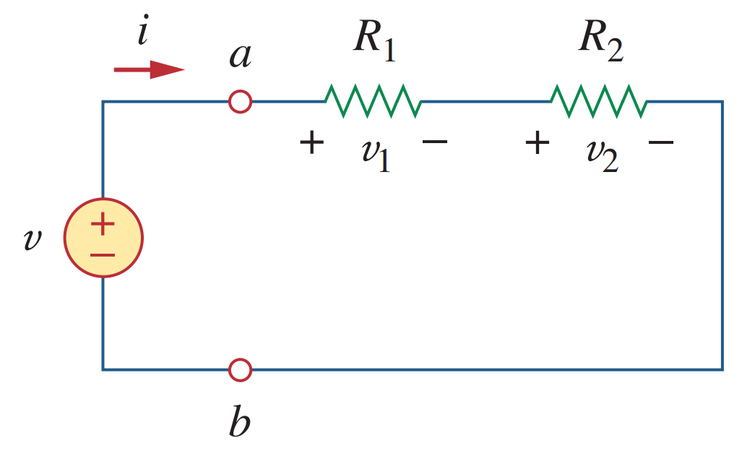
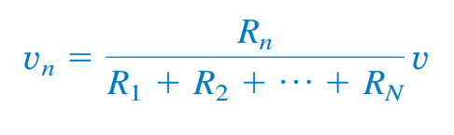
Series resistance and voltage divider rule

Slide 7

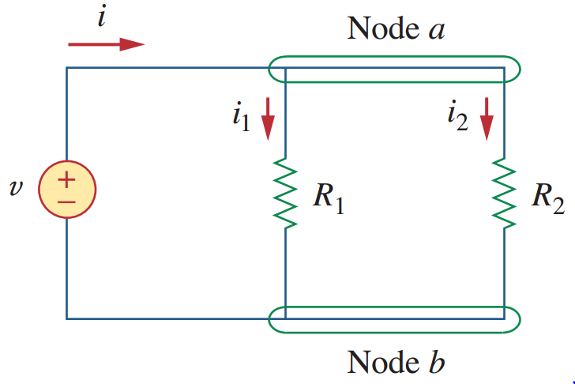
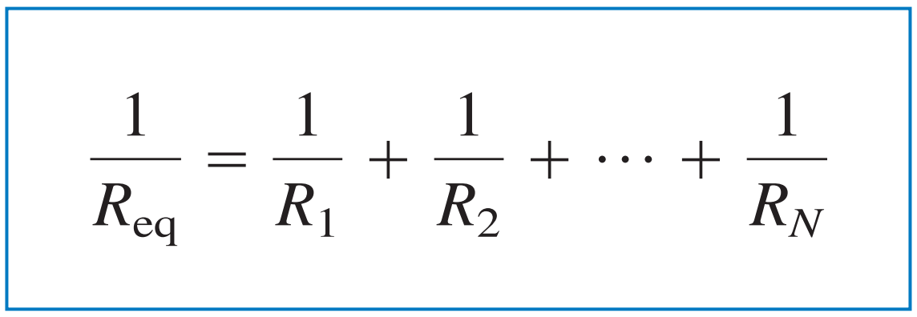
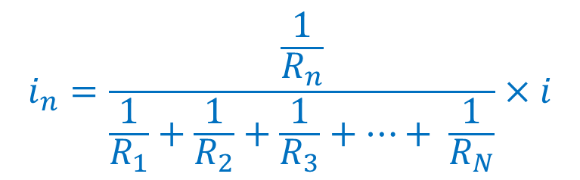
Parallel resistance and current divider rule
$$i_{n}=\frac{\frac{1}{R_{n}}}{\frac{1}{R_{1}}+\frac{1}{R_{2}}+\frac{1}{R_{3}}+…+ \frac{1}{R_{N}}}×i$$

Slide 8
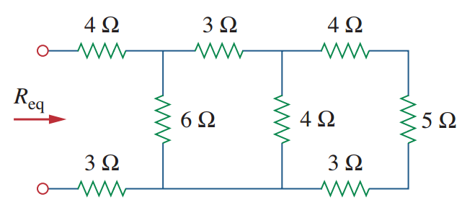
Problems

Slide 9
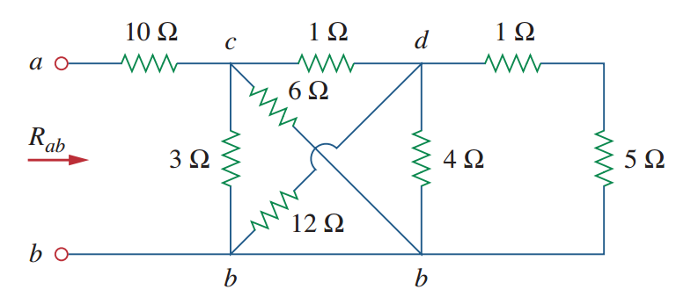
Problems

Slide 10
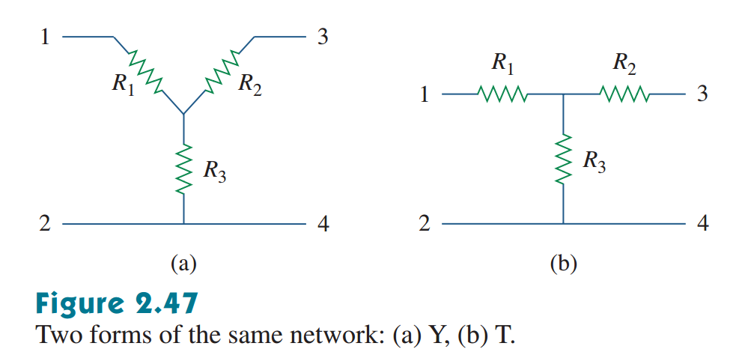
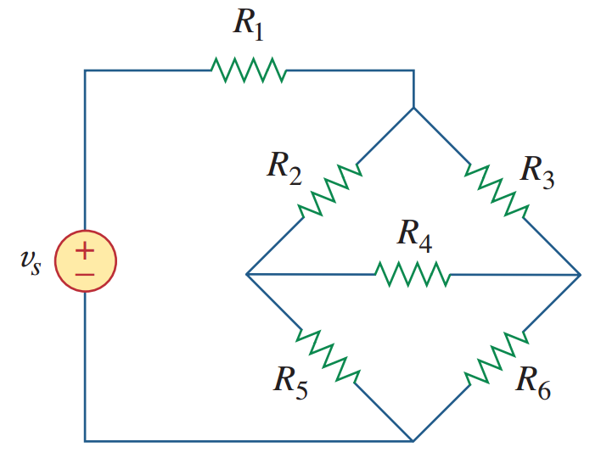
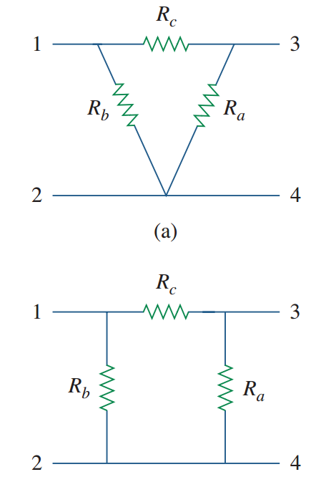
Wye-Delta Transformation
Wye
Tee
Delta
Pi

Slide 11
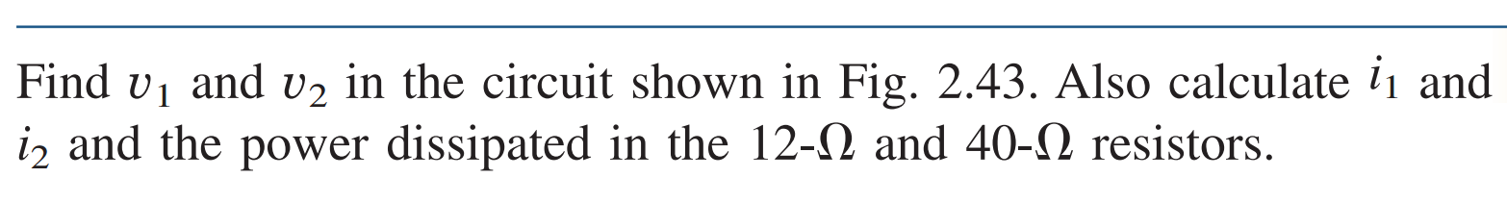
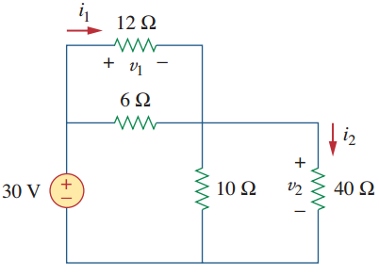
Problems

Slide 12
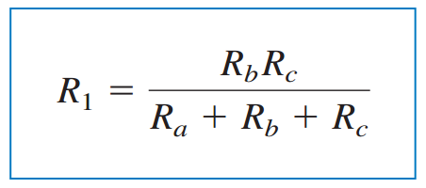
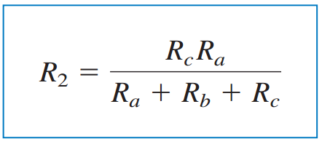
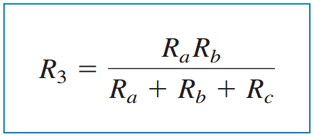
Delta to Wye Conversion

Slide 13
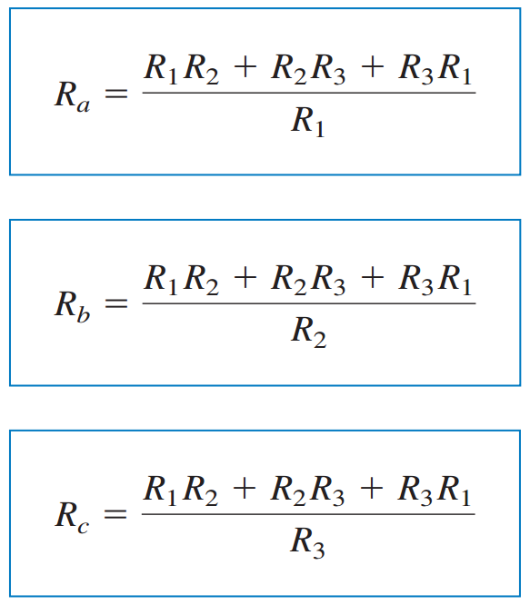
Wye to Delta Conversion

Slide 14
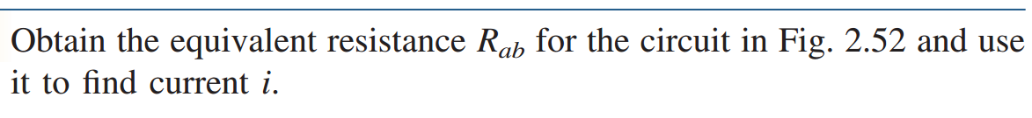
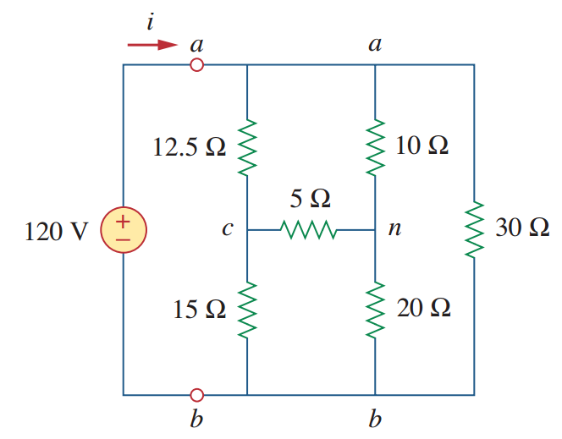
Problems

Slide 15
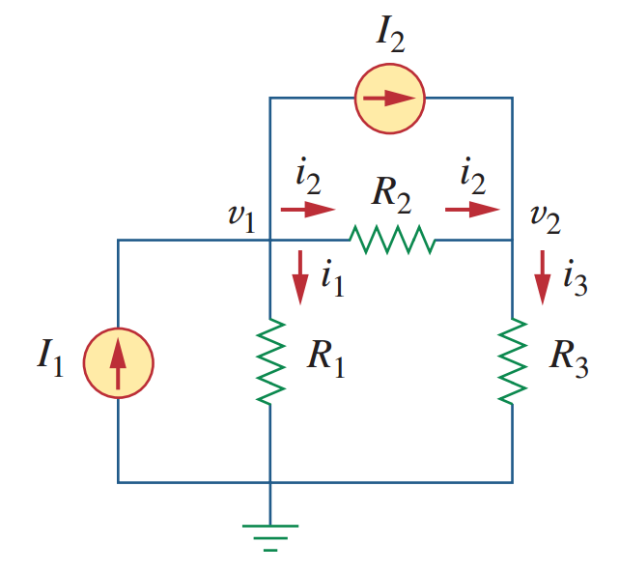
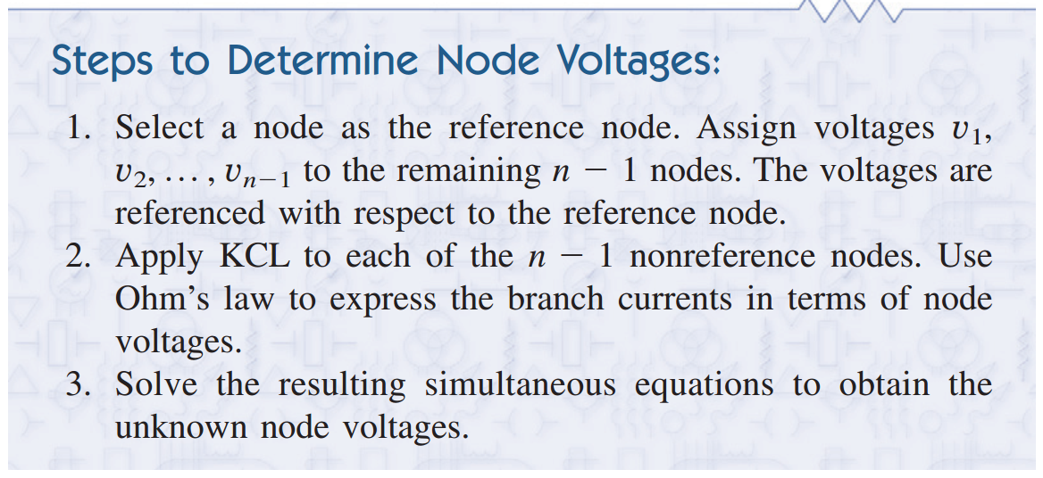
Nodal Analysis

Slide 16
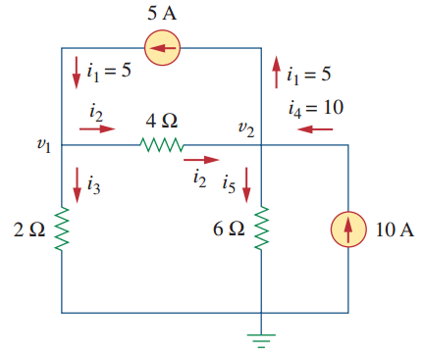
Nodal Analysis

Slide 17
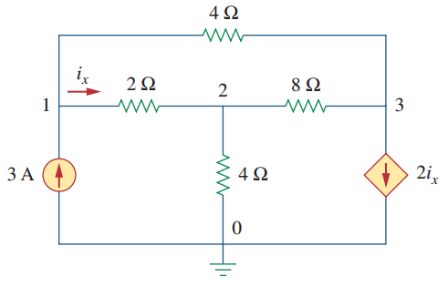
Nodal Analysis

Slide 18
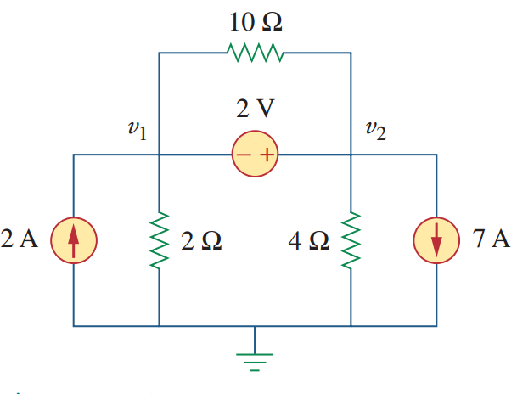
Supernode

Slide 19
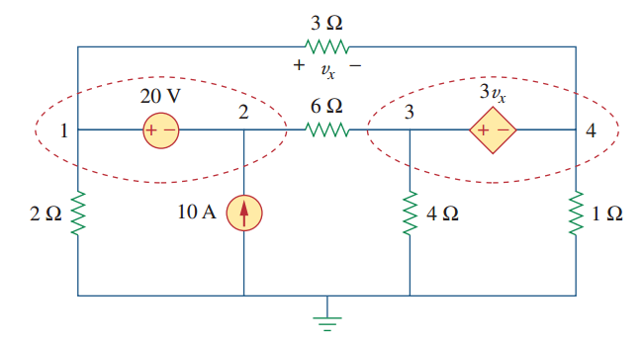
Supernode

Slide 20
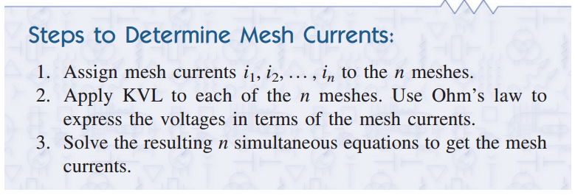
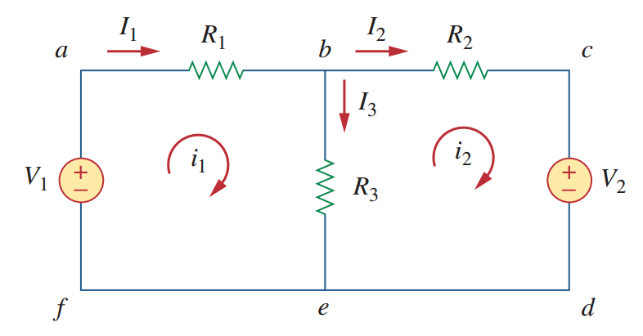
Mesh analysis

Slide 21
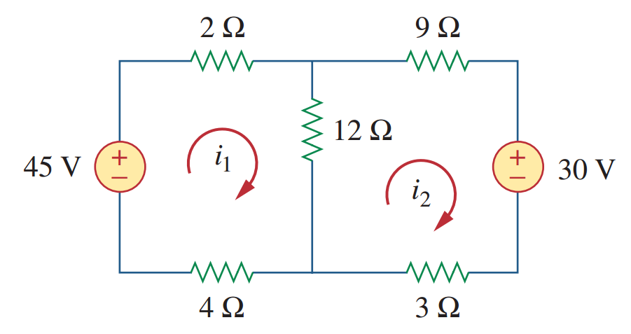
Mesh analysis

Slide 22
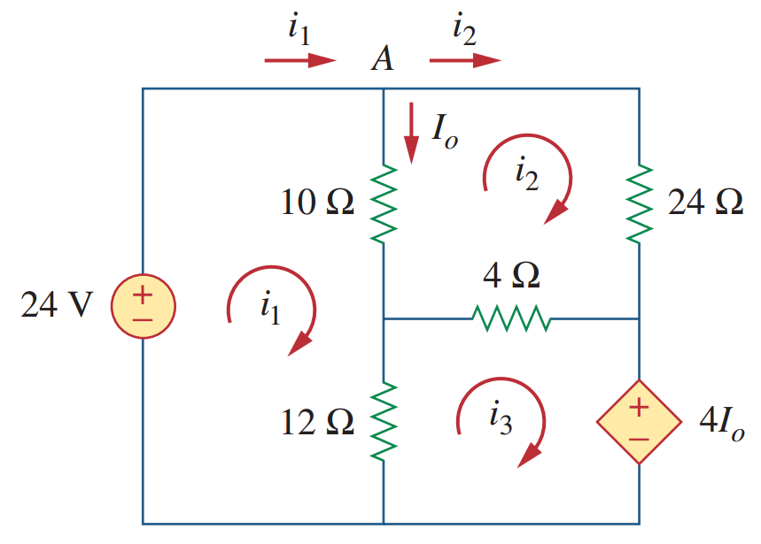
Mesh analysis

Slide 23
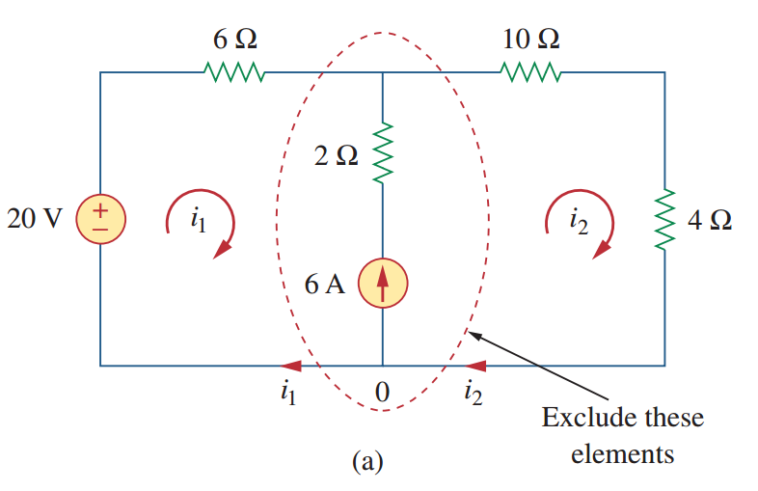
Supermesh

Slide 24
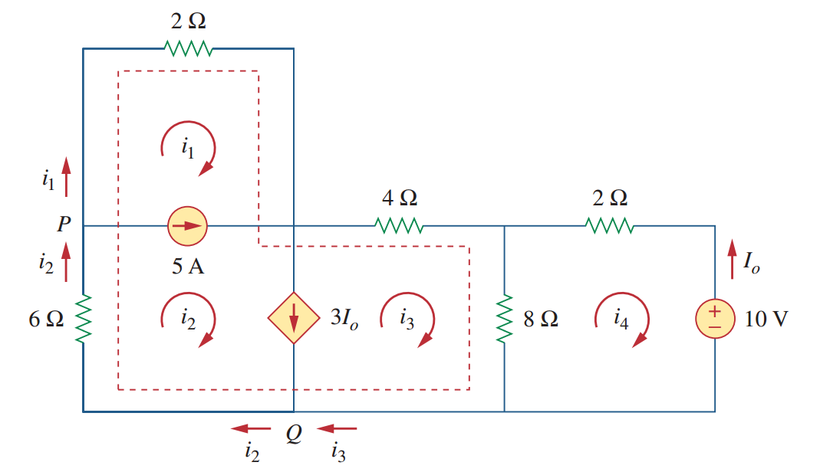
Supermesh

Slide 25
Practice problems
Sadiku Ch. 2
Solve relevant problems (as shown in class) from the book. Writing node-matrix or mesh-matrix equations by inspection is not needed. You can skip those.

Slide 26


